Slide 1
Welcome ! This is the Fitzhi platform

Slide 2
We choose this logo because,
it represents QUALITY in simplified Chinese,
and a human stands on it.

Slide 3
Fitzhì gathers & aggregates all quality data into a single tech-medal.

Slide 4
Fitzhì gathers & aggregates all quality data into a single tech-medal.

Slide 5
FINE !
Fitzhì maps the developers coverage
across the code hierarchy
Do you control each part of your applications
with your actual team ?
RISK ?

Slide 6
Fitzhì gathers & synthetizes the Sonar evaluation.
You get one single evaluation for the whole project.

Slide 7
Fitzhì formalizes the technical reviews and audit.

Slide 12
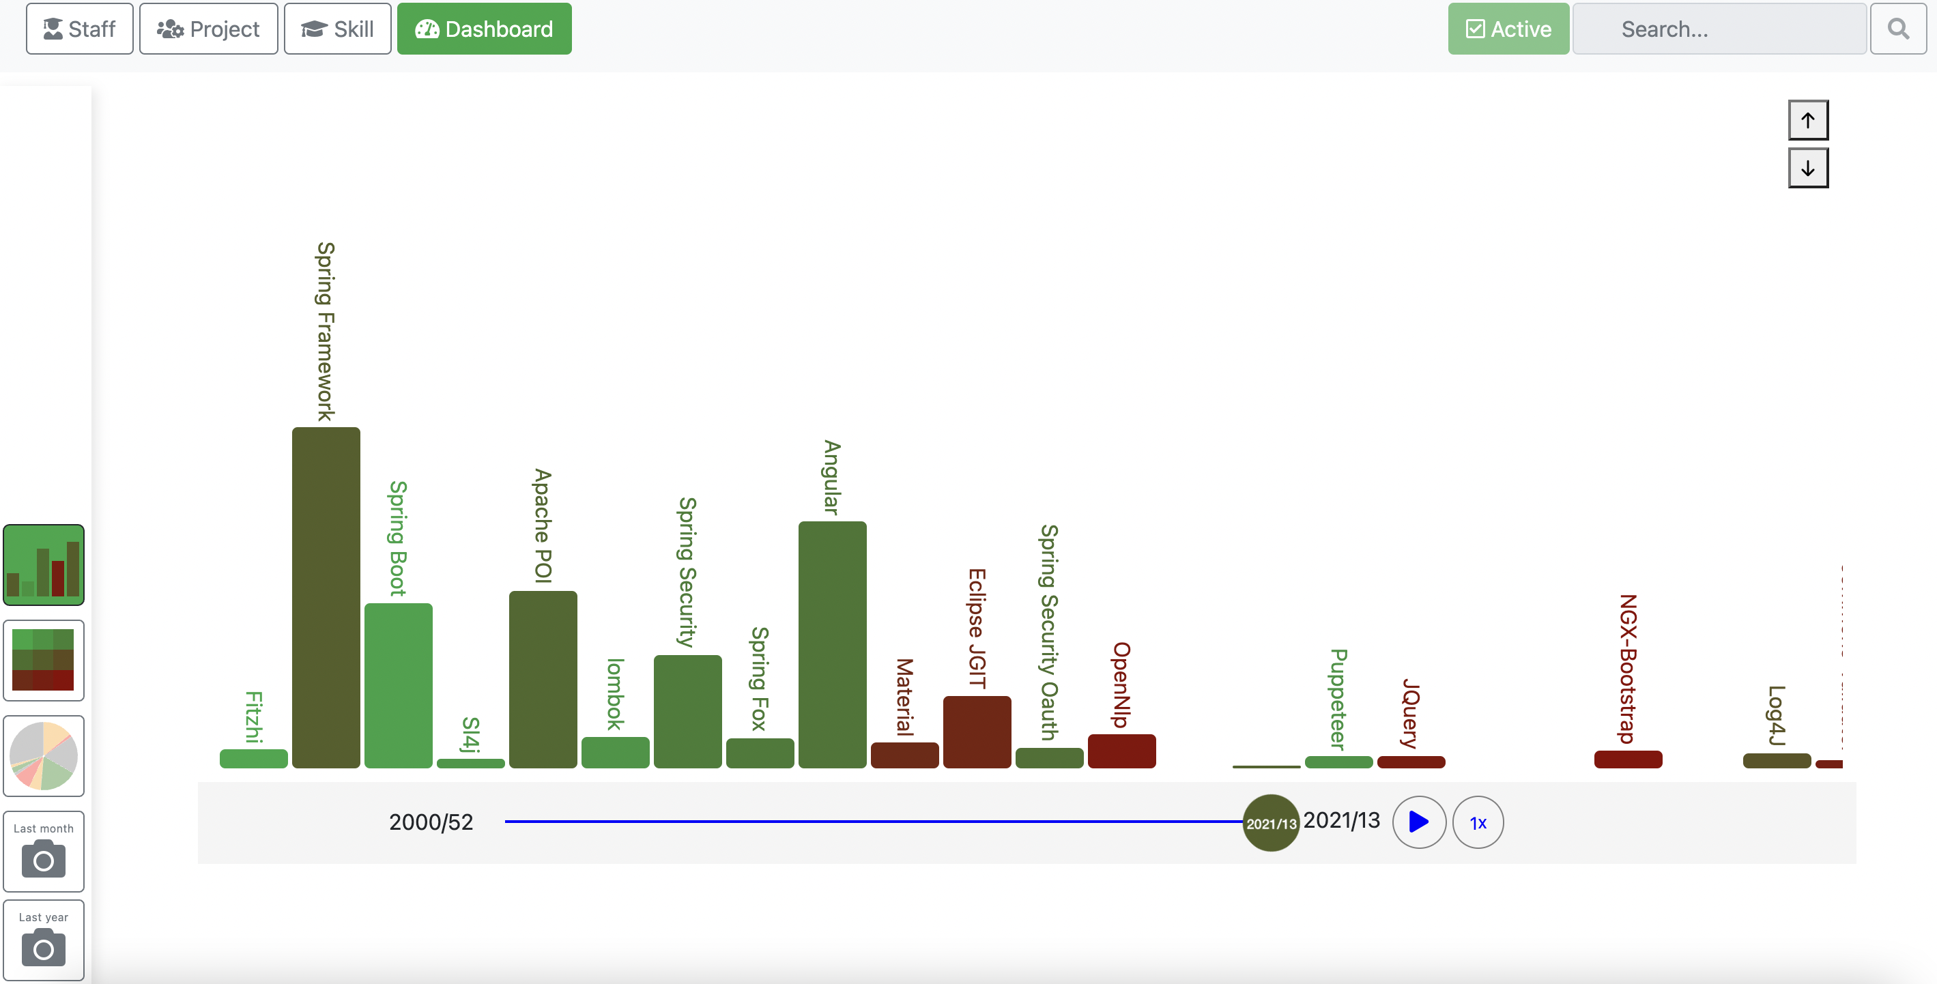

Slide 13
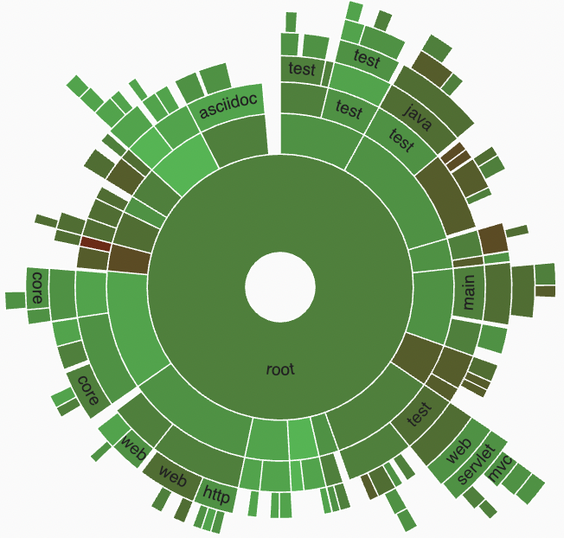

Slide 15




Slide 16



